Slide 1
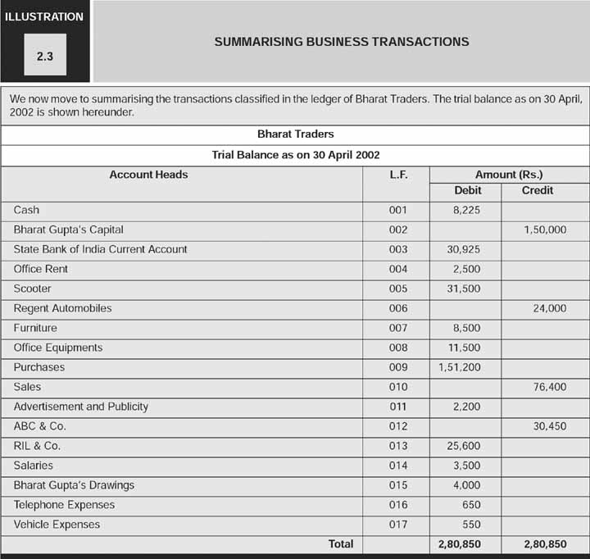
FRMA - Dr. Gaurav Agrawal, ABV IIITM

Slide 2
FRMA - Dr. Gaurav Agrawal, ABV IIITM

